Slide 1














Project presentation
Presented by
Manar Mohammed
Ahmed Mohammed
Mohammed Sobhy

Slide 2
Situation Statement
Effect:
Max12 is a training and consulting company specializing in training in the field of development and the labor market. There is a problem among university students and graduates in determining the actual steps for working in a certain field.
•They don't know how to work in the field that suits them and grow in it.
. • Confused between several ways to learn this field.
. •A problem that hinders their career path
Impact
Opportunity:
• Opportunity to increase our sales.
• It creates a new need for customers
There is a great need among students and graduates who want to know exactly what to study, from where, the most important certificates in the field, the job opportunities available, and the average salaries in it.

Slide 3
SWOT Analysis For Max12
1. max12 Provides valuable content and useful knowledge.
2. Max12 Company relies in its activities on practical application in sessions.
3. Some people trust in our courses
4. Have a strong operation team
S
O
1. There's a big need in Education filled.
2. There are not many competitors in this field.
1. Take along time to create new projects.
2 Don't have a strong sales & Marketing team.
1. Many competitors in the field of courses.
2. It is possible that the idea will be expanded quickly and sold at a lower price than us
W
T

Slide 4
Environment
People
Manufacturing
communications
Material
Fish model diagram
The Quality is good
Don't always check material of training
Sales and Marketing not qualified enough
We save time
Need some trainings
How can they define areas of work
We have a tracking system
The light is enough
miscommunications
among Head of sections
The place is not hot, but when there are a large number of people there, it becomes hot, and if we turn on the air conditioning, it makes an annoying sound

Slide 5
SMART Goal :
Max 12 Company wants to increase its customer base by 40% within 6 months to achieve a 30% increase in sales.”
Goal Two
SMART Goal Two: “Max 12 Company will hold every two weeks progress review meetings with 100% team attendance over the next 4 months to enhance communication, stay updated on the latest developments, and assess project results.”

Slide 6
OKRs
Enhancing project organization and success through effective communication among team members.
KR1
Achieve a 30% reduction in project delays within the next 60 days by tracking task completion rates.
KR2
Achieve a 45% reduction in project delays over the next 6 months by tracking completion rates.
KR3
Conduct bi-weekly progress review meetings with 100% team attendance for the next 90 days.

Slide 7
03- Increase youth awareness of available jobs in 5 fields.
KR1﻿
Understanding career paths in each field.
﻿
KR2﻿
75% of the attendees will know the suitable career path for them.
KR3
A decrease in the unemployment rate by 1%.

Slide 8
Stakeholders

Slide 9
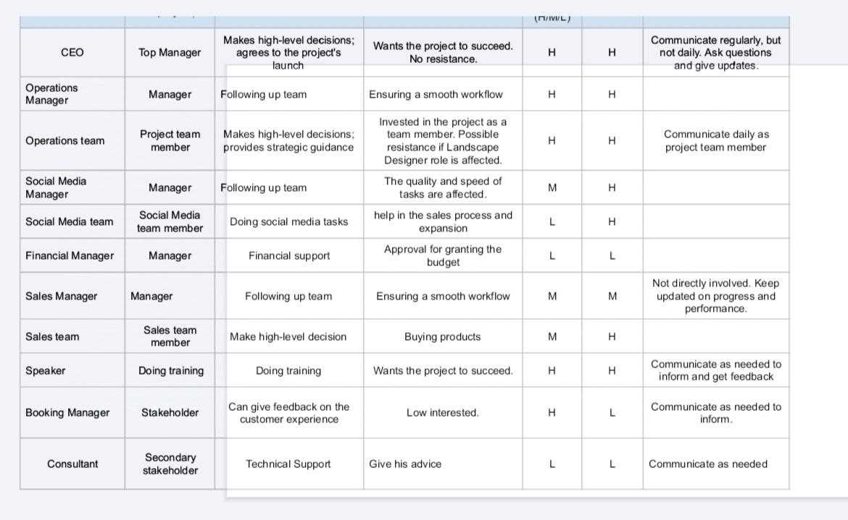

Slide 10
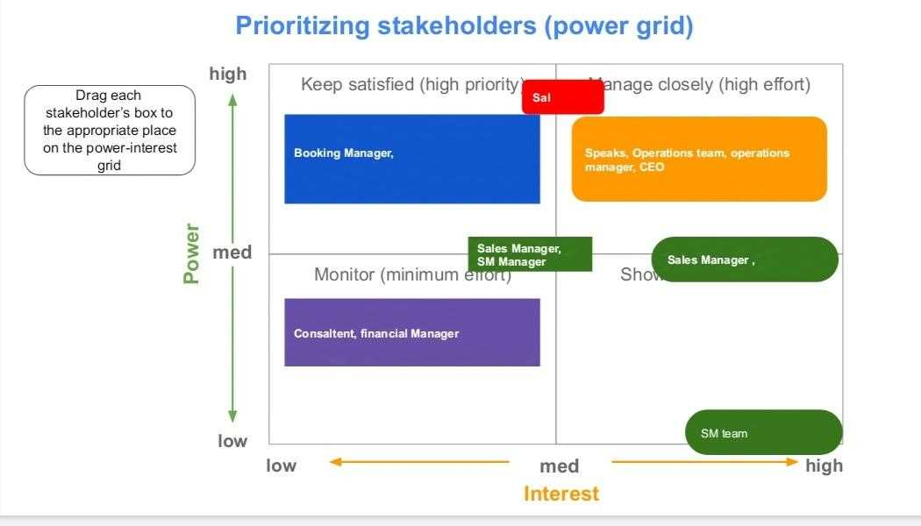

Slide 11
RACI Chart

Slide 12
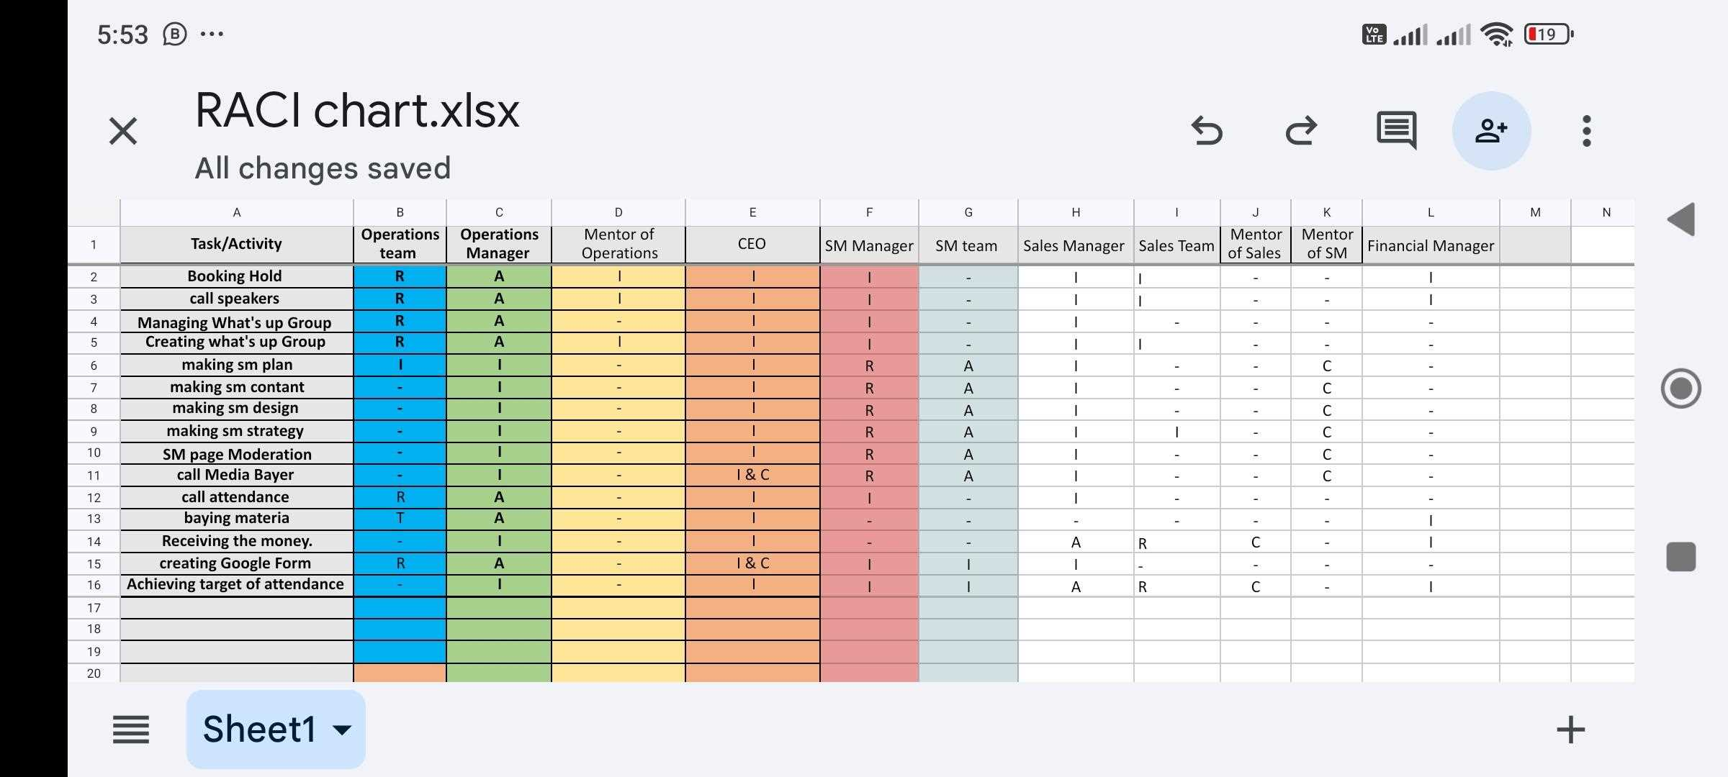

Slide 13
Project Charter

Slide 14
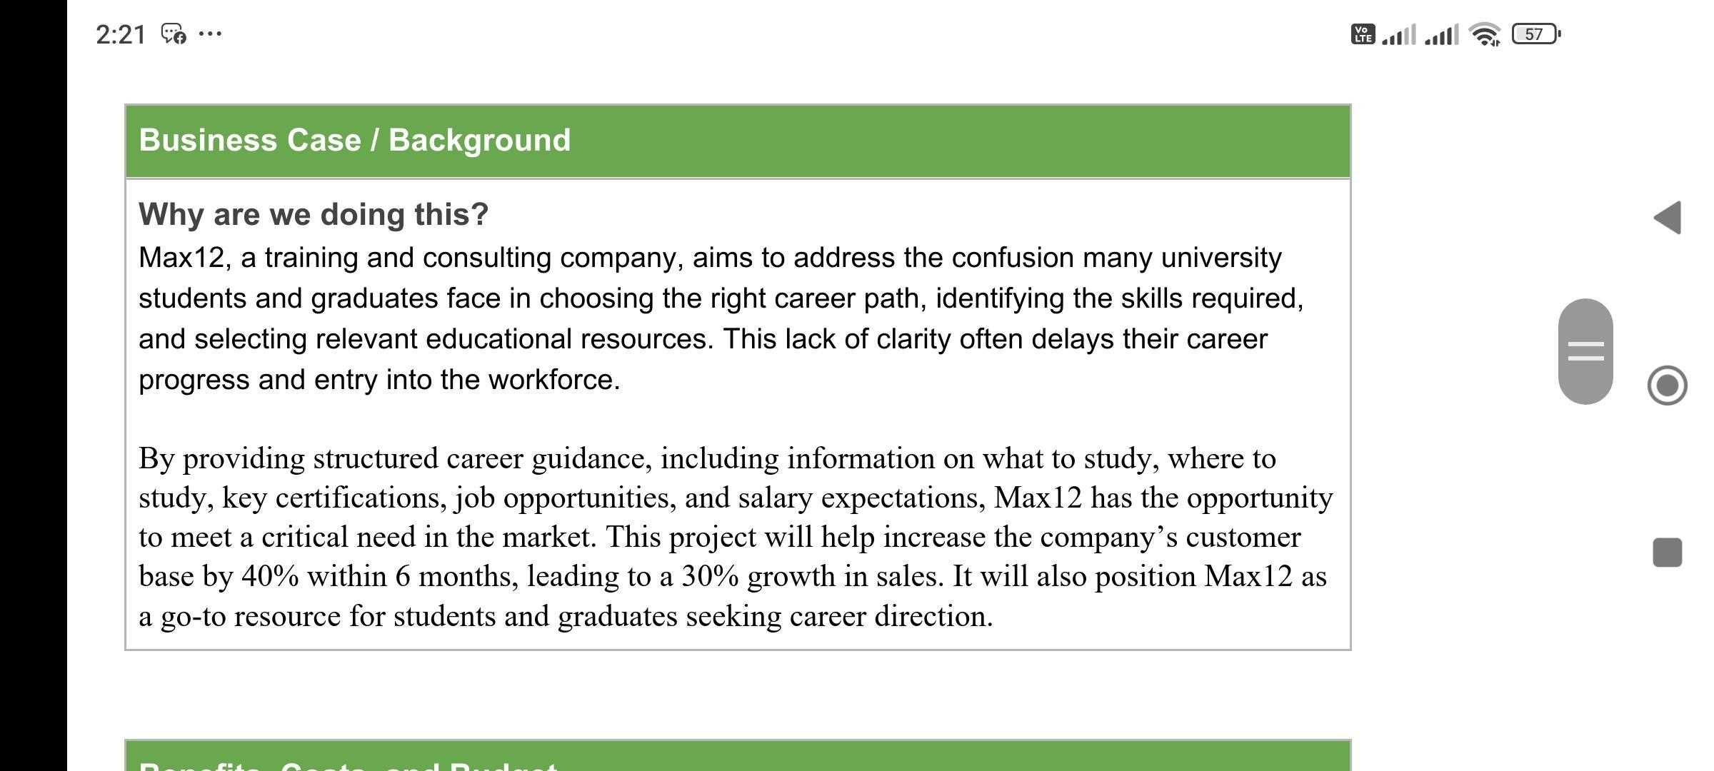

Slide 15
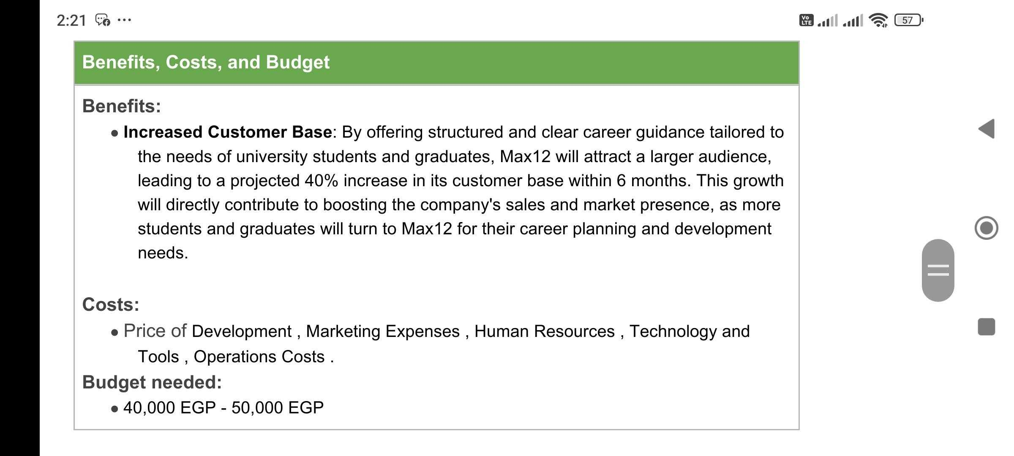

Slide 16
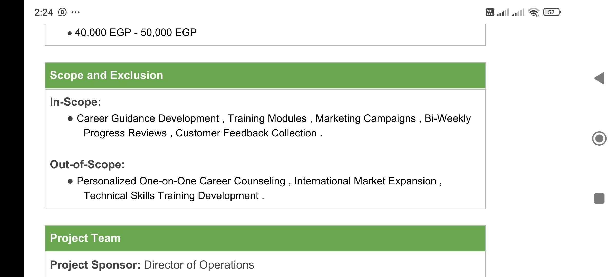

Slide 17
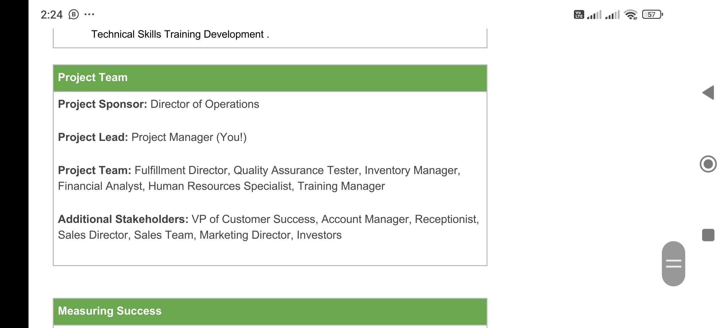

Slide 18
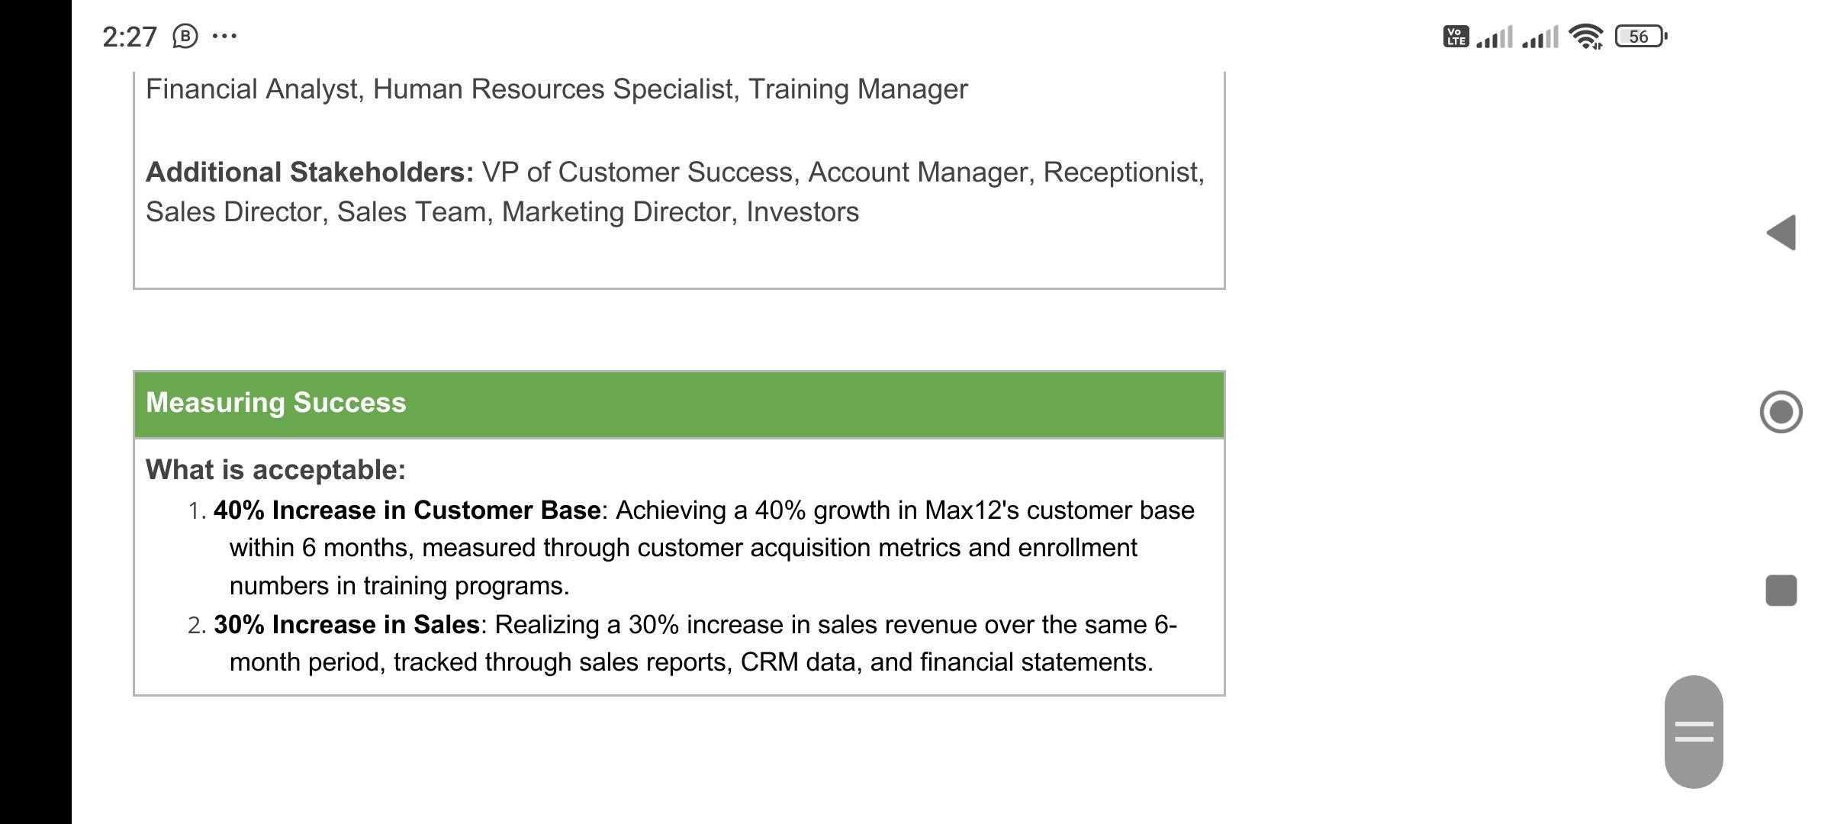

Slide 19
Risk Management

Slide 20
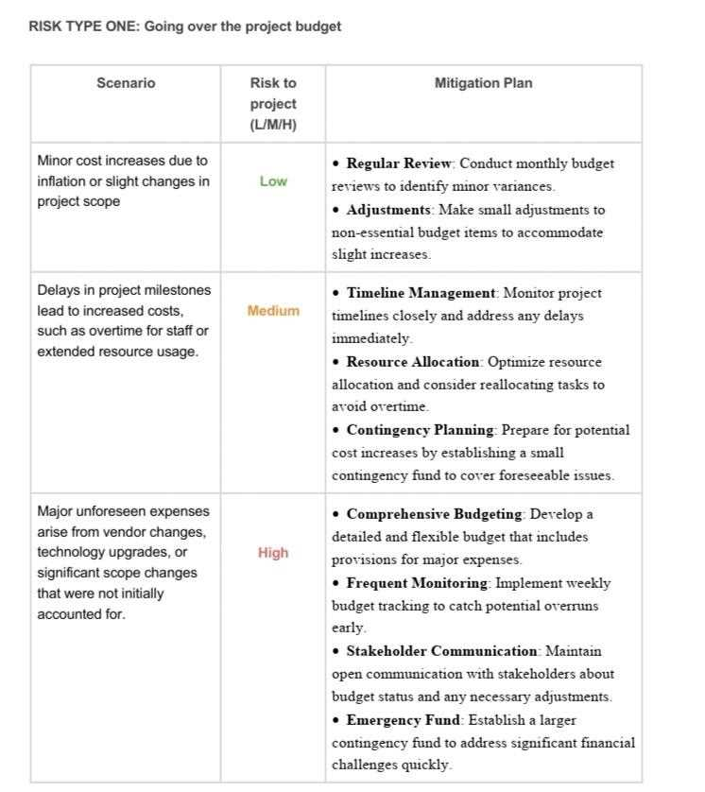

Slide 22
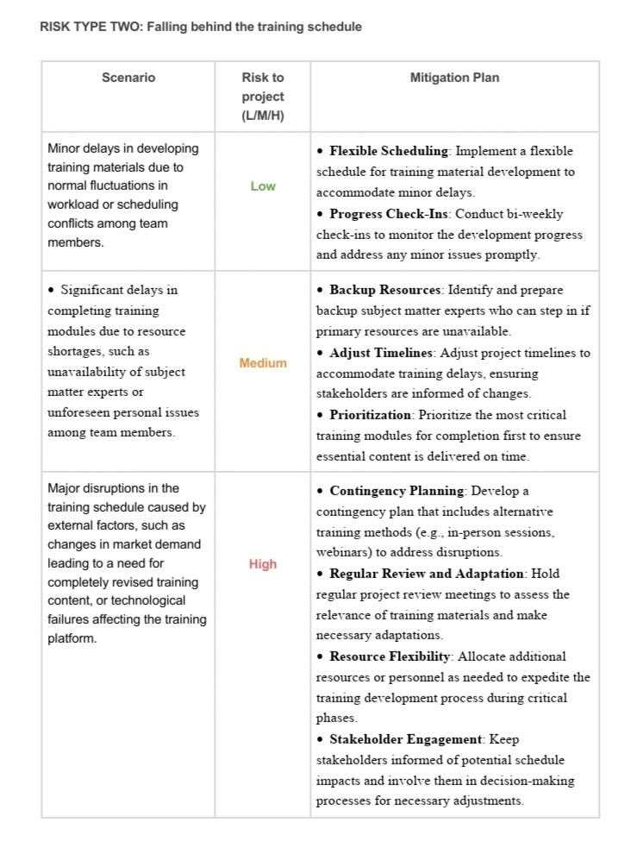

Slide 24
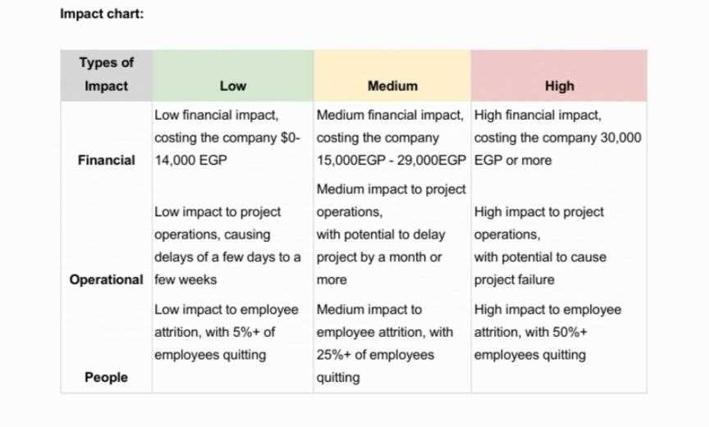

Slide 25
WBS

Slide 26
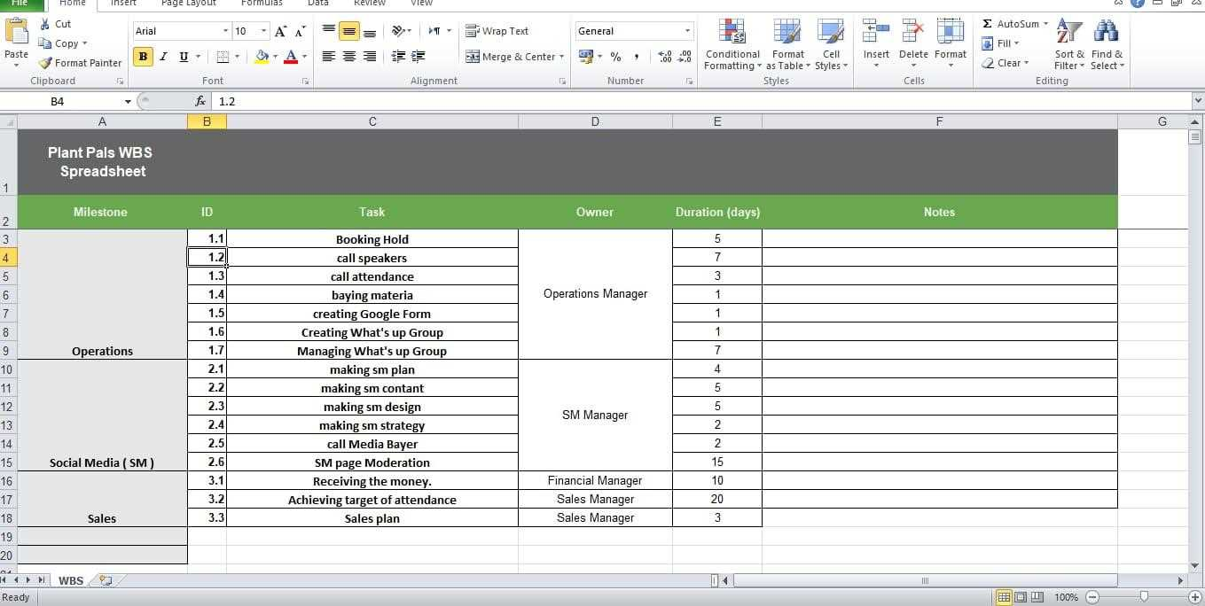

Slide 27
WBS
Operations
SM
Sales
Booking Hold
SM page Moderation
Achieving target of attendance
call speakers
call attendance
making sm contant
Receiving the money
baying materia
making sm design
creating Google Form
making sm strategy
Making What's up Group
call Media Bayer
Managing What's up Group
making sm plan

Slide 28
creating Google Form
Booking Hold
Call Speakers
baying materia
Start
Creating SM Design
Managing What's up Group
Finish
making sm strategy
making sm plan
Creating sm contant
call attendance
Receiving the money.
Making What's up Group
call Media Bayer
SM page Moderation
Sales plan
Achieving target of attendance

Slide 29
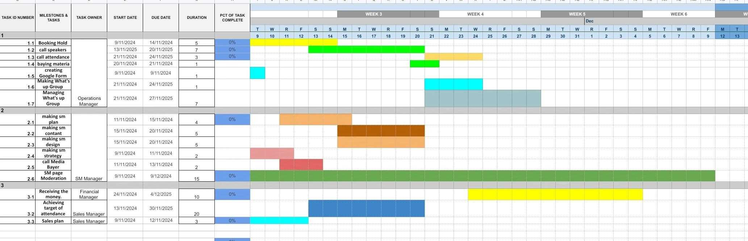

Slide 30
Budget

Slide 31
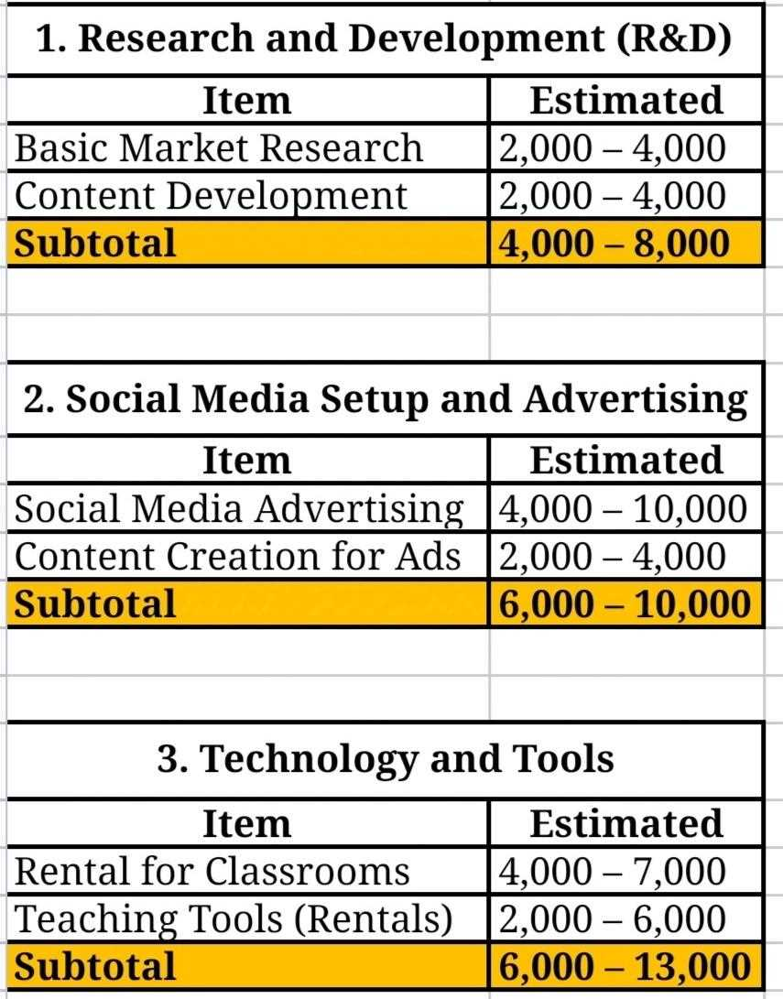

Slide 32
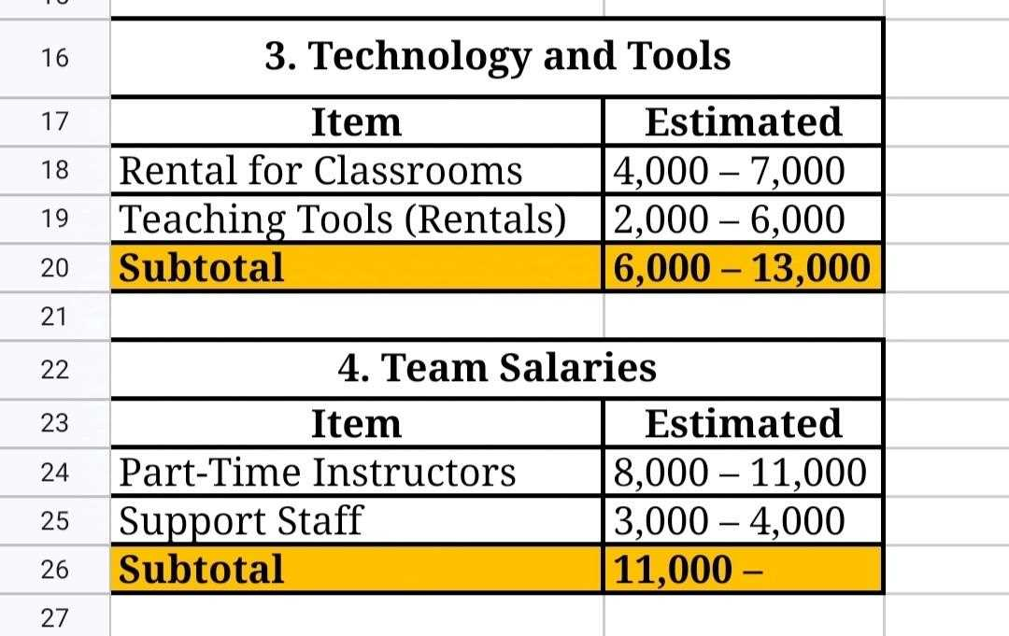

Slide 33
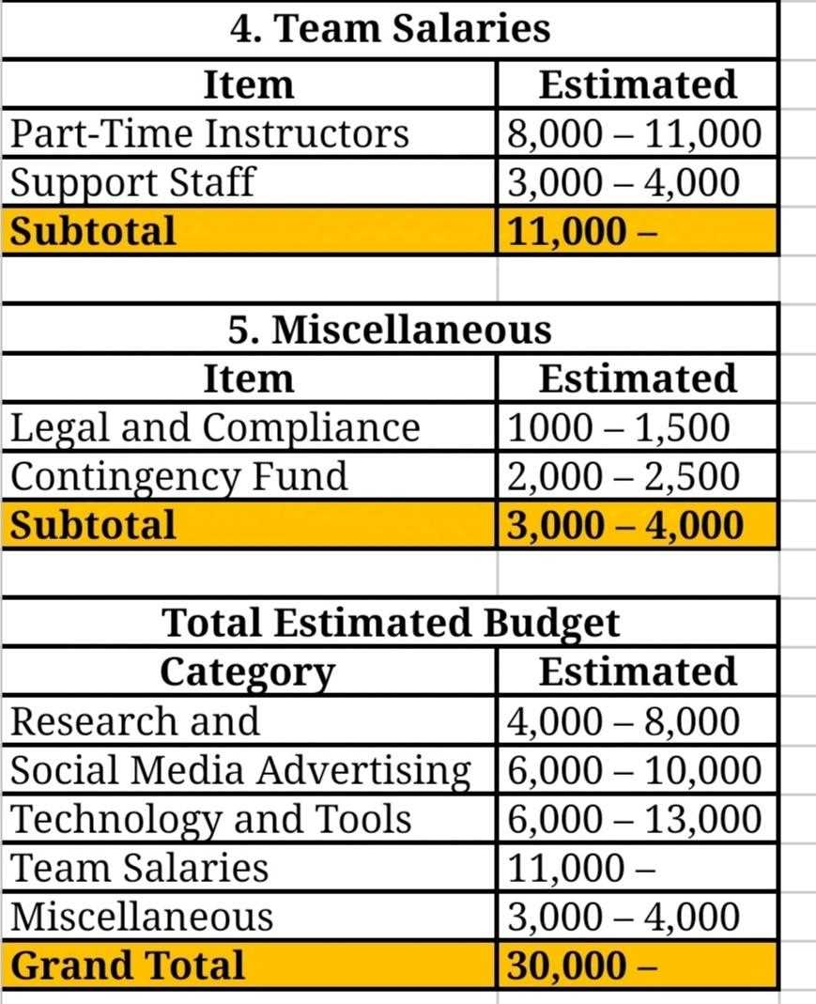

Slide 34
Communication plan

Slide 35
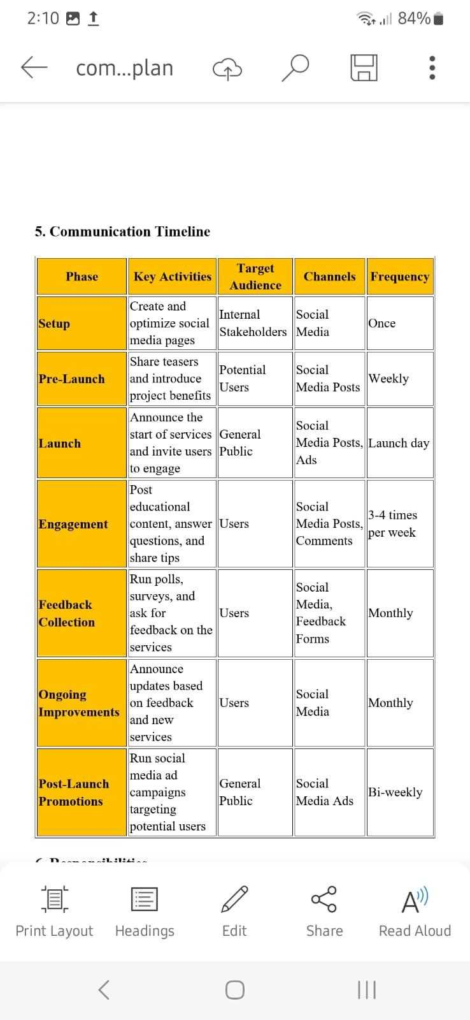

Slide 38
Project Link
https://drive.google.com/drive/folders/1WQXHtwiZ_N_SWzEZU5ztU2JC-zw84f_4

Slide 39
Questions

Slide 40
Thank you

